Slide 1

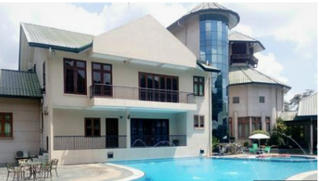

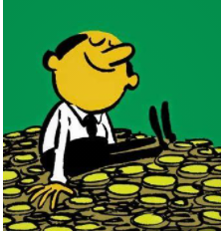

monster
GROUP 5
Alliance
HOME OWNERSHIP SOLUTION
CASH-STRAP INDIVIDUALS
Desire home ownership
CASH-EXCESS INDIVIDUALS
Interested to invest in property in Singapore
Pool Resources

